Slide 1
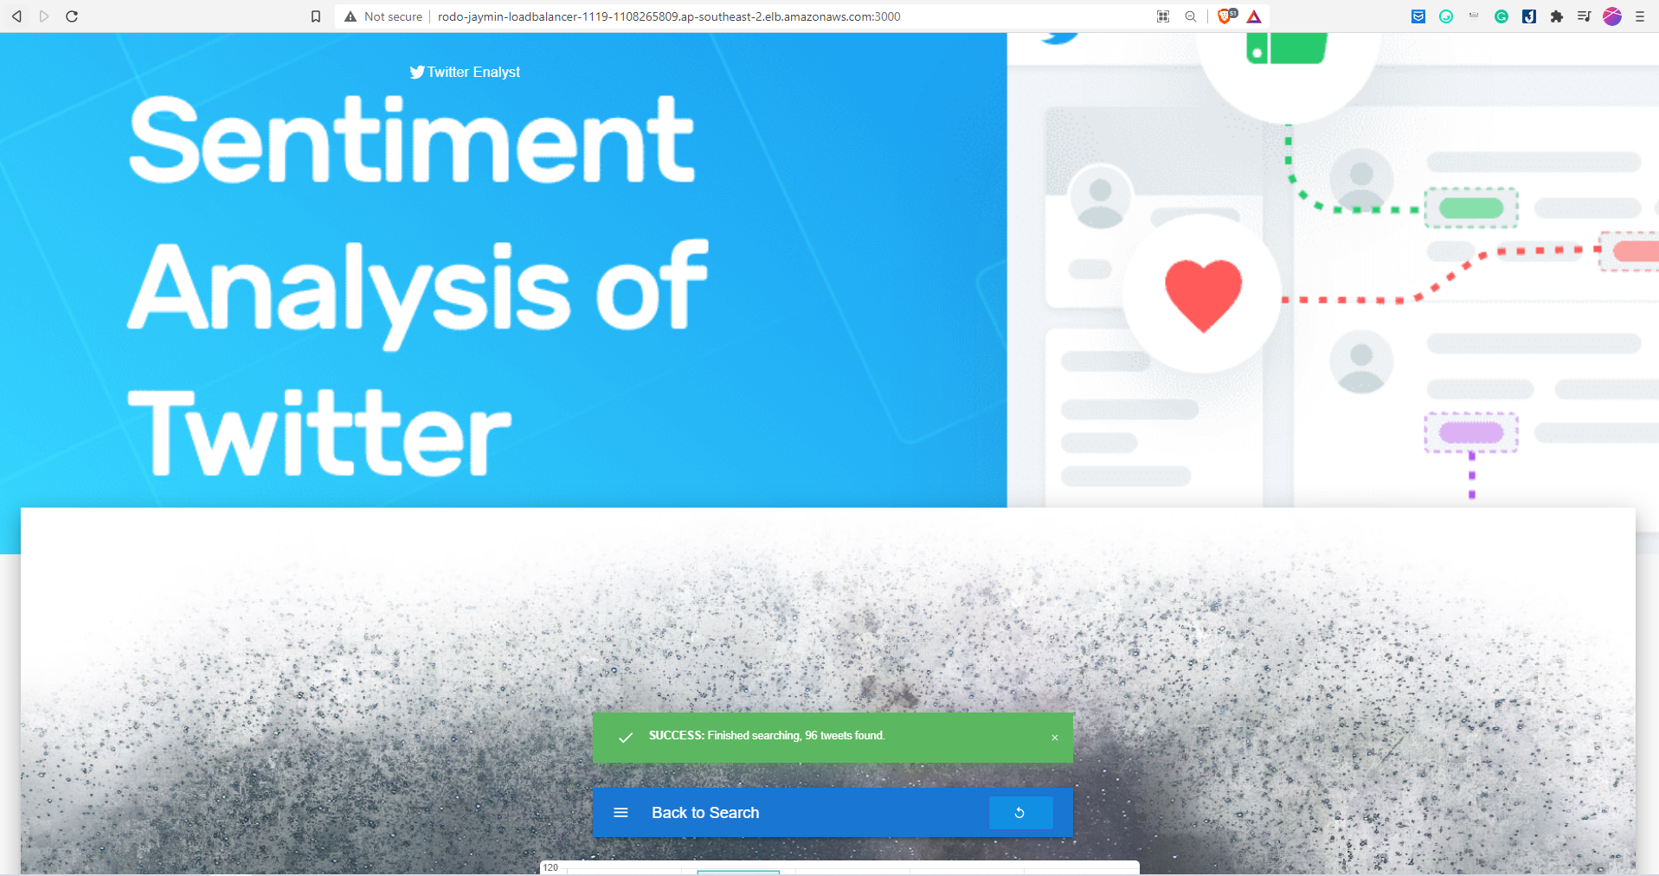

Jaymin Do (n10570926)
Rodo Nguyen (n10603280)

Slide 2
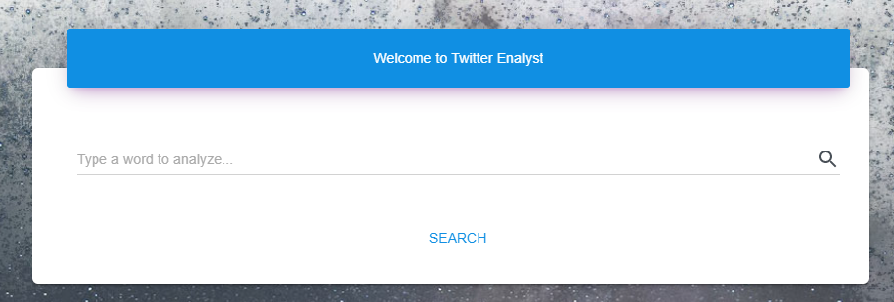
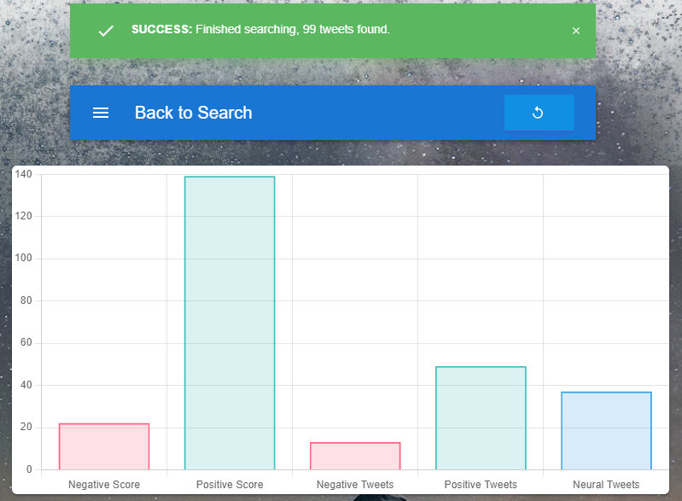
Twitter Enalyst
→
Analyzing sentiment scores of Tweets that contains user’s input keyword

Slide 3
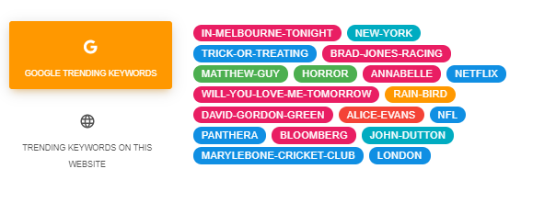
Suggests Google trending keywords and our website trending keywords

Slide 4

Display the relevant tweets that are used to calculate sentiment scores
Image: Tweets containing “web”

Slide 5
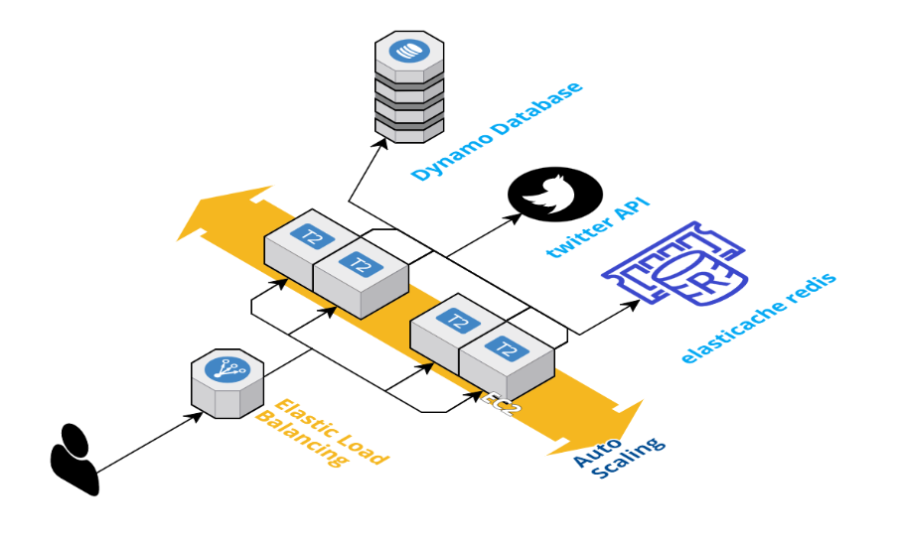
The Architecture
Notes:
Standing between users and server is the elastic load balancer. Each has redis installed on it to stored analyzed results for later use. Dynamo is our second level of persistence. If the request is completely new, then the server will request directly from Twitter API

Slide 6
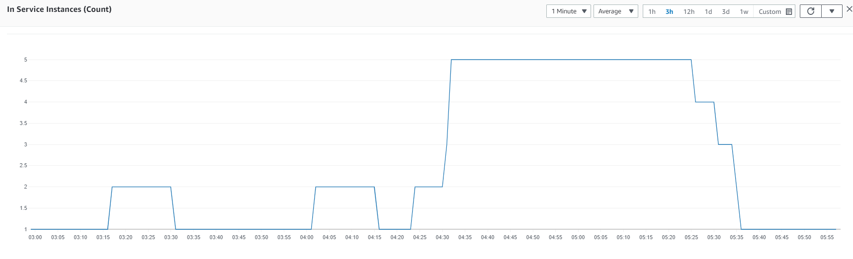
← Scaling →
Figure: In-service instances snapshot
Notes:
For scaling part, we managed to get it scale between 1 and 5 instances when thousands of requests are generated from postman

Slide 7
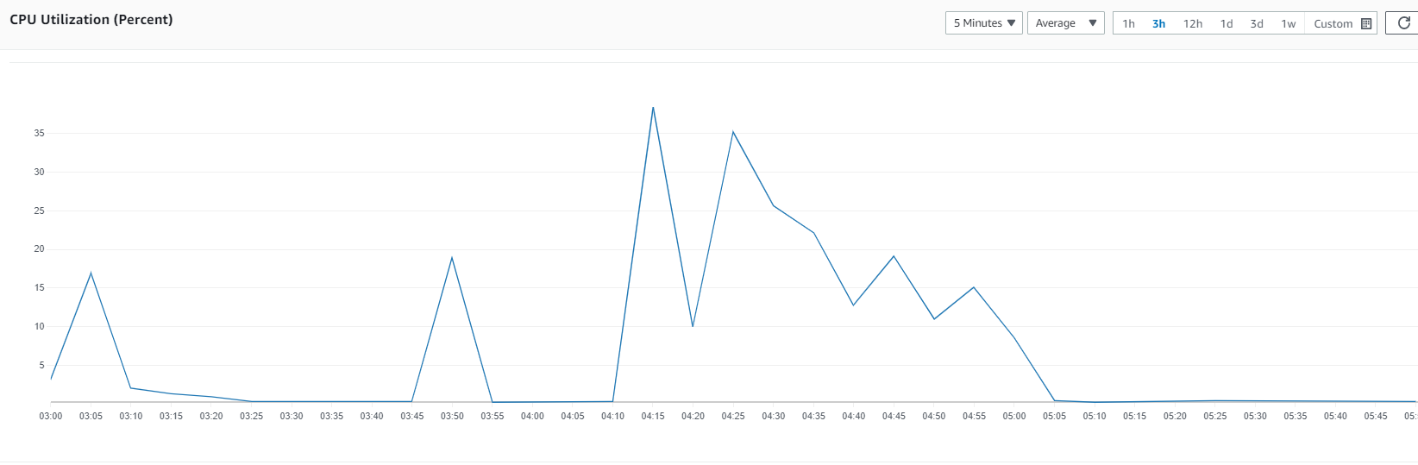
← Scaling →
In-service instances
Vs.
CPU utilization
Notes:
The scaling policy is that a new instance is called when CPU utilization passes 20%. The reason we set 20% is due to Twitter API request quota and load can only created in mass when the server analyzes new results from Twitter API. From these images, it can be observed that the number of in-service instances changes proportionally with CPU utilization. However, there is a small delay of a few minutes for a new instance to be spawned and ready.

Slide 8
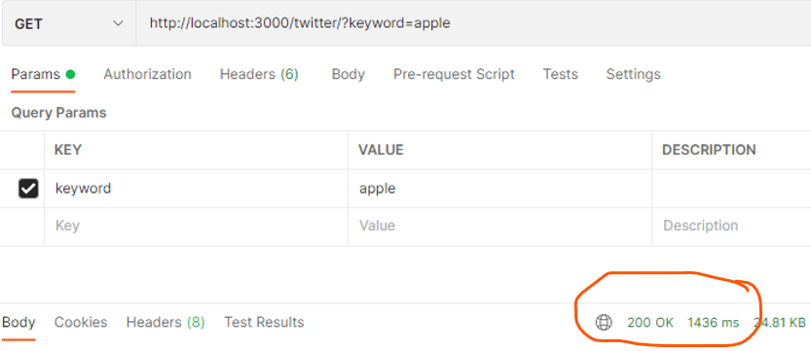
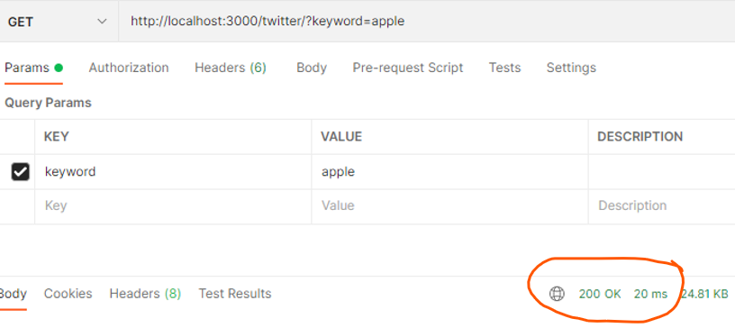
Request Tweets directly from Twitter API and analyze…
Latency: 1436 ms
Results have been stored and retrieved from Redis on Instance
Latency: 20 ms !
Notes:
And here you can see the huge difference in Latency when responding client from Twitter API and from Redis.

Slide 9
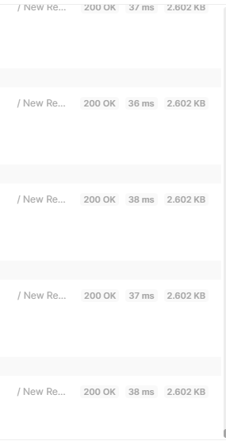
During the scale-out, the app succeeds in maintaining low latency at high volume of requests.

Slide 10
Thank You !

